Slide 1
Fuzzy Clustering and Fuzzy C-means Algorithm

Slide 2
Fuzzy Clustering
We will first try to put the concepts of Clustering in a Mathematical Framework
At a very basic level, clustering involves partitioning available data from several samples or observations into some number of sets or clusters, in a manner that the intra-cluster similarity between observations is high, and the inter-cluster similarity between observations is low
Formally, each observation (sample) consists of n variables grouped into a column vector z_{k} = [z_{1k}, z_{2k,} …, z_{nk}]^{T}, with z_{k} ∈ ○^{n}
A set of N such observations can be denoted as
Z = {z_{k} | k = 1, 2, …, N} and can be represented as an n X N matrix Z as

Slide 3
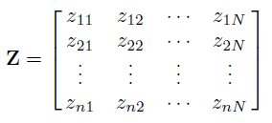
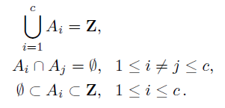
Fuzzy Clustering
…. (1)
The objective of clustering is to partition the data Z into c number of clusters, where for the time being assume that c is known
A hard partition of Z can be defined as a family of subsets A_{i}, 1 ≤ i ≤ c, with the following properties
… (2a)
… (2b)
… (2c).

Slide 4
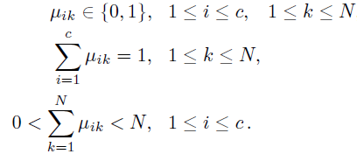
Fuzzy Clustering
One of the most important concepts associated with clustering in a general (hard or fuzzy) context is that of the membership function
To express the membership function, we first define a Partition Matrix U of size c x N, composed of elements μ_{ik} such that
The i^{th} row of this matrix contains values of this membership function μ_{i} of the i^{th} subset A_{i} of Z
Now it follows from (2) that a partition of Z must satisfy conditions:
… (3a)
… (3b)
… (3c).

Slide 5

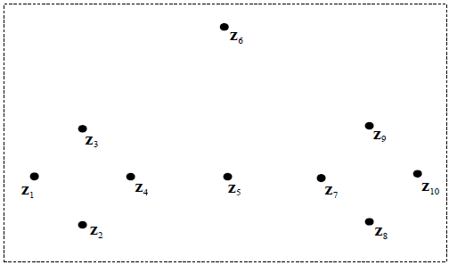
Fuzzy Clustering
On the basis of eq. (3), one may define the complete space of all possible hard partition matrices U of Z, called the hard partitioning space M_{hc} as
Let us illustrate the concept of hard partition by a simple example:
Consider the data set Z = {z₁, z₂, …, z₁₀} composed of 10 pts. in 2-D:

Slide 6

Fuzzy Clustering
How many clusters do you think this makes? 2, 3 or 4? Any outliers?
One particular partition of the data into 2 subsets could be:
However, are we not erroneously pushing z₅ into Cluster A₁?
Further, z₆ is far away from both clusters, why should we include it?
It is clear that hard partitioning does not realistically reflect underlying data!

Slide 7

Fuzzy Clustering
So let us look at Fuzzy partitioning
Instead of forcing a point to lie in either A₁ or A₂, we give it a degree of belonging to either
Degree of belonging simply implies giving continuous values between 0 and 1 to the elements μ_{ik} of the partition matrix U
So a realistic partition of the example data could be:

Slide 8
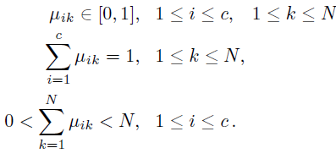

Fuzzy Clustering
Formally, a Fuzzy Partition of Z will satisfy the following conditions:
… (4a)
… (4b)
… (4c)
And one may define the space of all Fuzzy Partition matrices U of Z, called M_{fc}, as

Slide 9
Fuzzy Clustering
But there is still a lacuna in the fuzzy partitioning ……
The degree of belonging of z₆ to both A₁ and A₂ should be much less than the degree of belonging of z₅ to both
But the cond. (4b) imposes that net degrees of membership of a data sample to all clusters should add to 1 – hence this incongruity
So another variant of fuzzy partitioning makes (4b) less restrictive

Slide 10
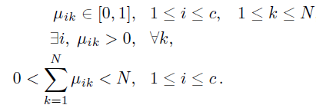


Fuzzy Clustering
On relaxing condition (4b), it can be called unconstrained fuzzy partitioning, or Possibilistic partitioning:
… (5a)
… (5b)
… (5c)
And one may define the space of all Possibilistic Fuzzy Partition matrices U of Z, called M_{pc}, as
With a corresponding variant for the given example as:

Slide 11


Fuzzy C-Means Algorithm
With the obtained understanding of the utility and different forms of Fuzzy Partitioning, one is now in a position to get into the Fuzzy C-means algorithm for clustering:
We start by defining the Fuzzy C-means Objective Function, or Fuzzy C-means Functional (original formulation by Dunn (1974) and Bezdek (1981)):
… (6)
where U is a Fuzzy Partition matrix of Z: … (7)
V is a vector of cluster centroids to be determined, and expressed as … (8)
and is a parameter that determines the fuzziness level of the resulting clusters. One can express the norm used in the summand term as … (9)
at its simplest A can be thought of as an Identity Matrix, but more later.

Slide 12

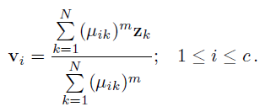
Fuzzy C-Means Algorithm
Further, it may be shown that for the Functional in (6) to minimize for m > 1, we need to have
… (10)
and concurrently … (11)
it should be clear from (11) that any centroid v_{i} is the weighted mean of all z_{k} (i.e. data samples) by the degree of belonging of the z_{k} to the cluster i (that’s why it is called “C-means” algorithm)
so if the degree of belonging of a particular sample k to a cluster i is zero, that sample does not contribute to the positioning of the centroid of that cluster.

Slide 13
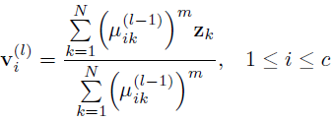
Fuzzy C-Means Algorithm
So having now seen the ingredients, let us put together the step-by-step algorithm:
Step 0: Read the data set Z, choose the number of clusters c as 1 < c < N, the fuzziness level m > 0, the error threshold ε and the norm- inducing matrix A
Step 1: Initialize the partition matrix randomly, such that U⁽⁰⁾ ∈ M_{fc}
Step 2: Advance iteration loop, increment iteration number l
Step 3: Compute the cluster means using
… (A)
Step 4: Compute the distances:
… (B)

Slide 14


Fuzzy C-Means Algorithm
Step 5: Update the elements μ_{ik}^{(l)} of the partition matrix U^{(l)} as
for 1 ≤ k ≤ N
if D_{ikA} > 0 for all i = 1, 2, …, c
… (C)
else (i.e. D_{ikA} = 0 for some k and i combination)
set μ_{ik}^{(l)} = 1 for that k and i pair, and μ_{ik}^{(l)} = 0 for
all other i**
Step 6: Check if . If True, Stop, else return to Step 2. For calculation purpose, consider the value of this norm as the (abs of) largest element of this difference matrix.
** effectively and physically, D_{ikA} = 0 implies that the data sample k precisely coincides with the centroid of cluster i. In that case there is no scope for fuzziness, the degree of belonging of sample k is precisely 1 for that cluster i and 0 for all other clusters.

Slide 15
Fuzzy C-Means Algorithm: Some additional tips
Let us revisit Step 0 and look at the various parameters that the user needs to decide for partitioning of a given dataset Z:
Step 0: Choose the number of clusters c as 1 < c < N, the fuzziness level m > 0, the error threshold ε and the norm-inducing matrix A
The Number of Clusters c: Use exactly the same approach used in K-Means algorithm, i.e. once you converge with your partition matrix in Step 6, evaluate the value of the Fuzzy Objective Function J used in eq. 6, and then go over a sequence of c’s and finally plot J vs. c to decide on best value of c
The fuzziness level m : Just choose m = 2, unless you would like to experiment
The error threshold ε: Really depends on the nature of the values in your data. Idea is to go for highest accuracy, start with 0.001, then you may try with one zero less or more

Slide 16
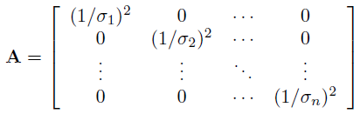
Fuzzy C-Means Algorithm: Some additional tips
The Norm-Inducing Matrix A: Simplest choice is A = I, which reduces D_{ik}² to the L₂ norm. An alternate choice is to use
which neutralizes variations along the different dimensions of z
Finally, if you refer back to the algorithm, you will find we are first initializing U and then following the iterative update sequence :
U^{(l)} → V^{(l+1)} → U^{(l+1)} → V^{(l+2)} → .....
Alternately, one can initialize V and follow the update sequence:
V^{(l)} → U^{(l+1)} → V^{(l+1)} → U^{(l+2)} → .....
with the final convergence check on V rather than U.

Slide 17
THANK YOU

